Slide 1
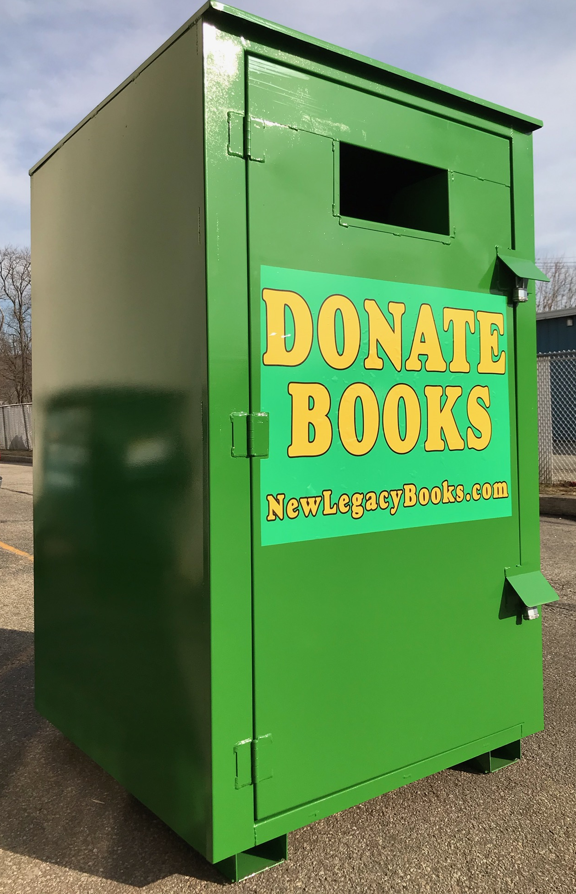
New Legacy Books
Our company history
How our book processing works
How the fundraiser works

Slide 2
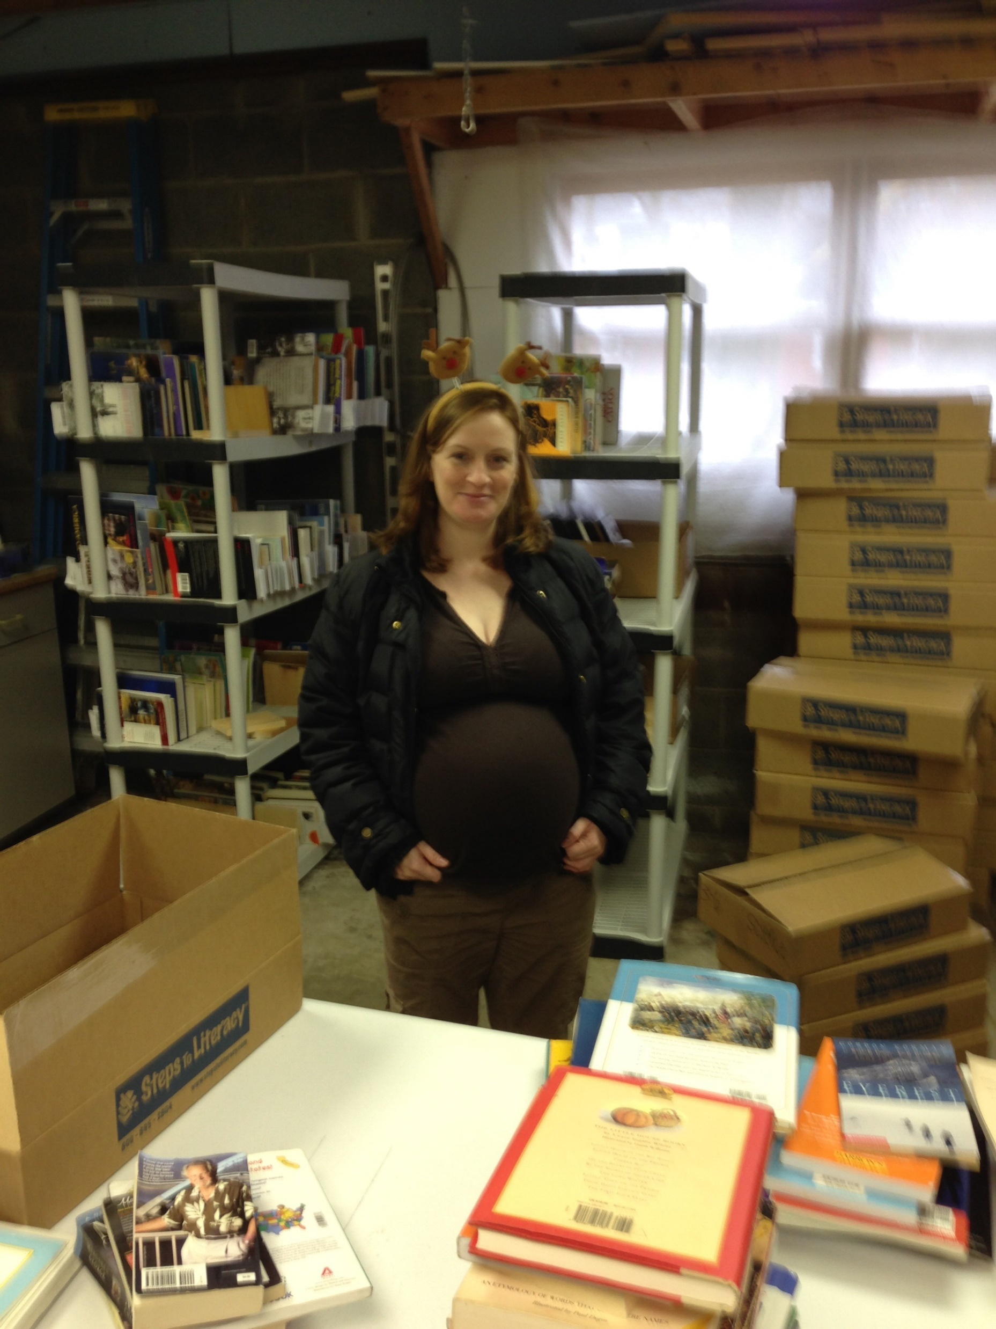
2013

Slide 3
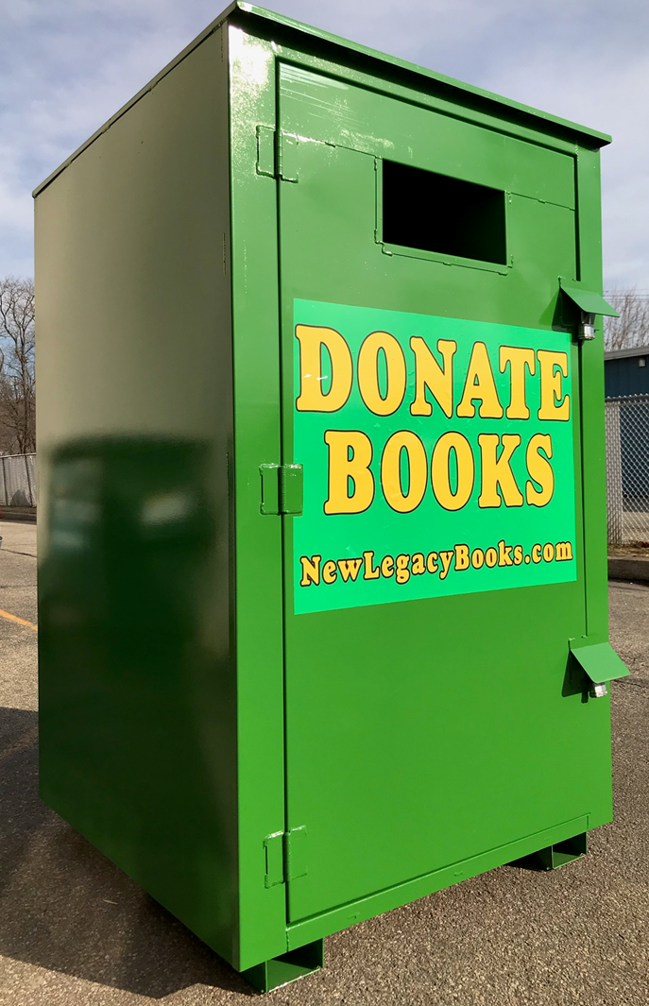
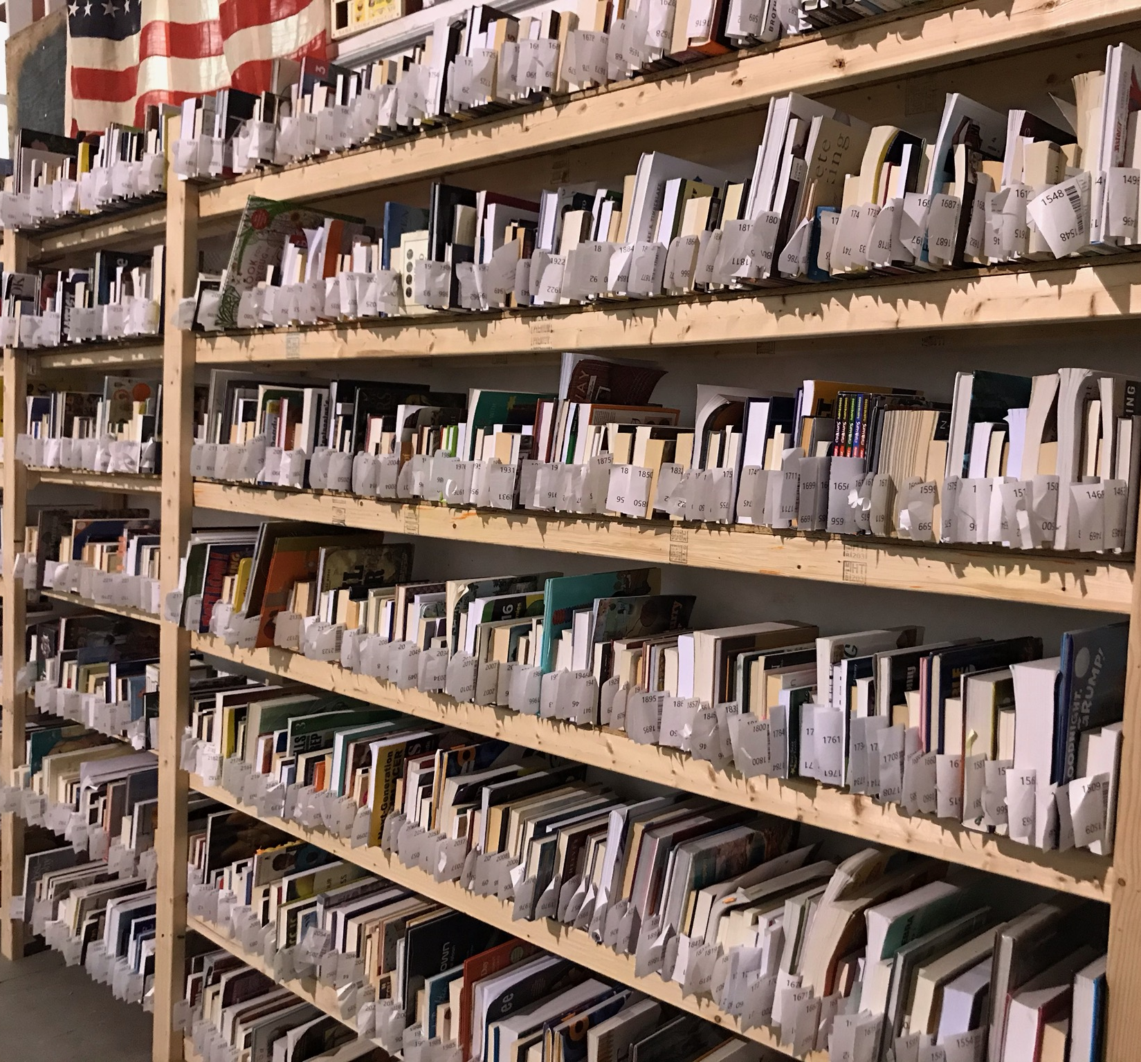
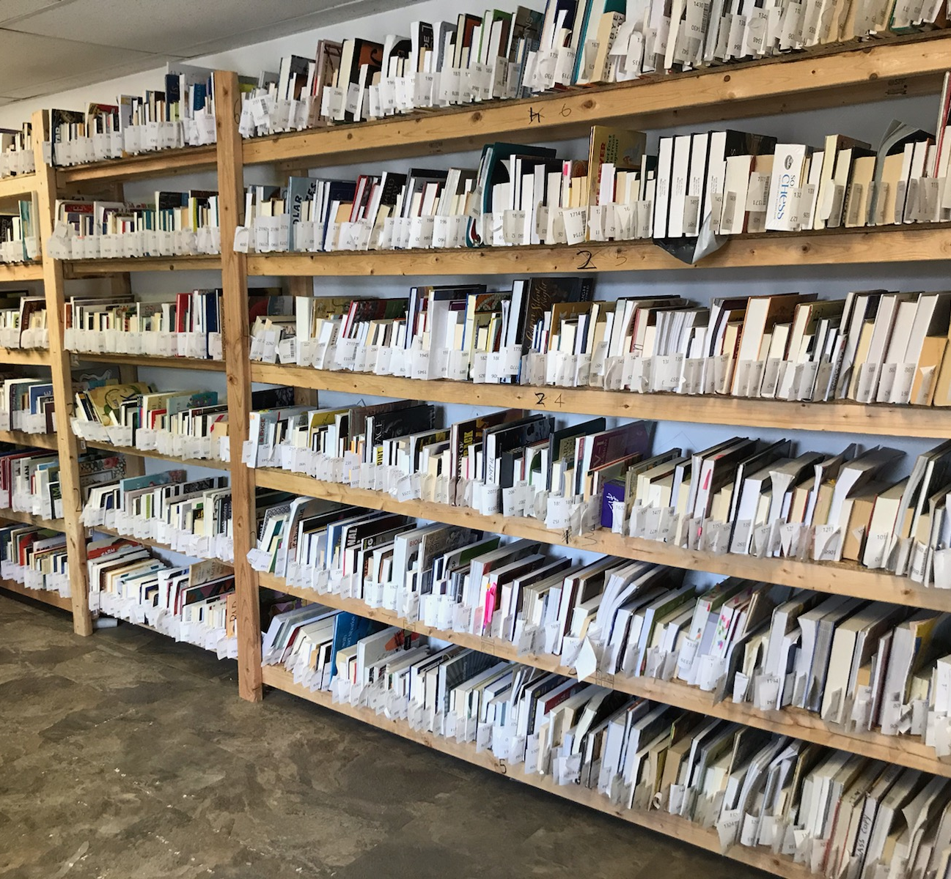
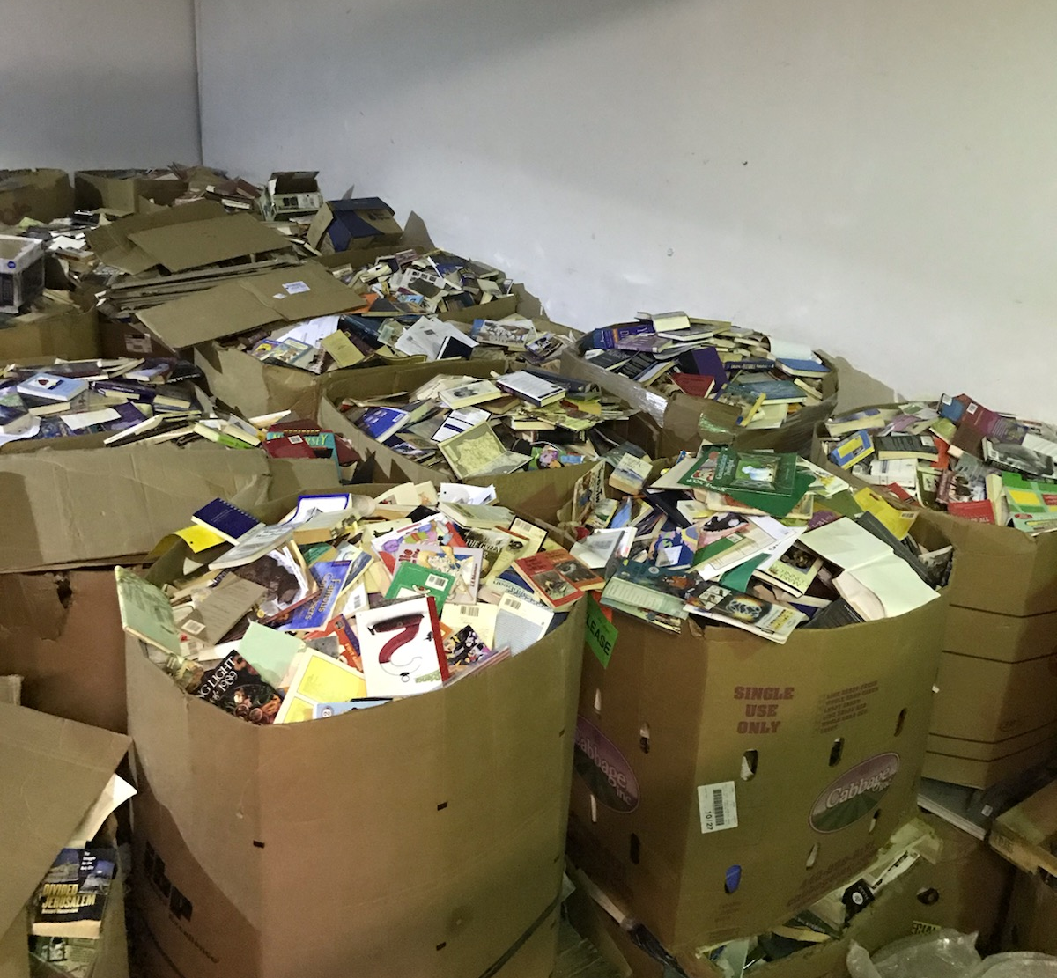

Slide 4
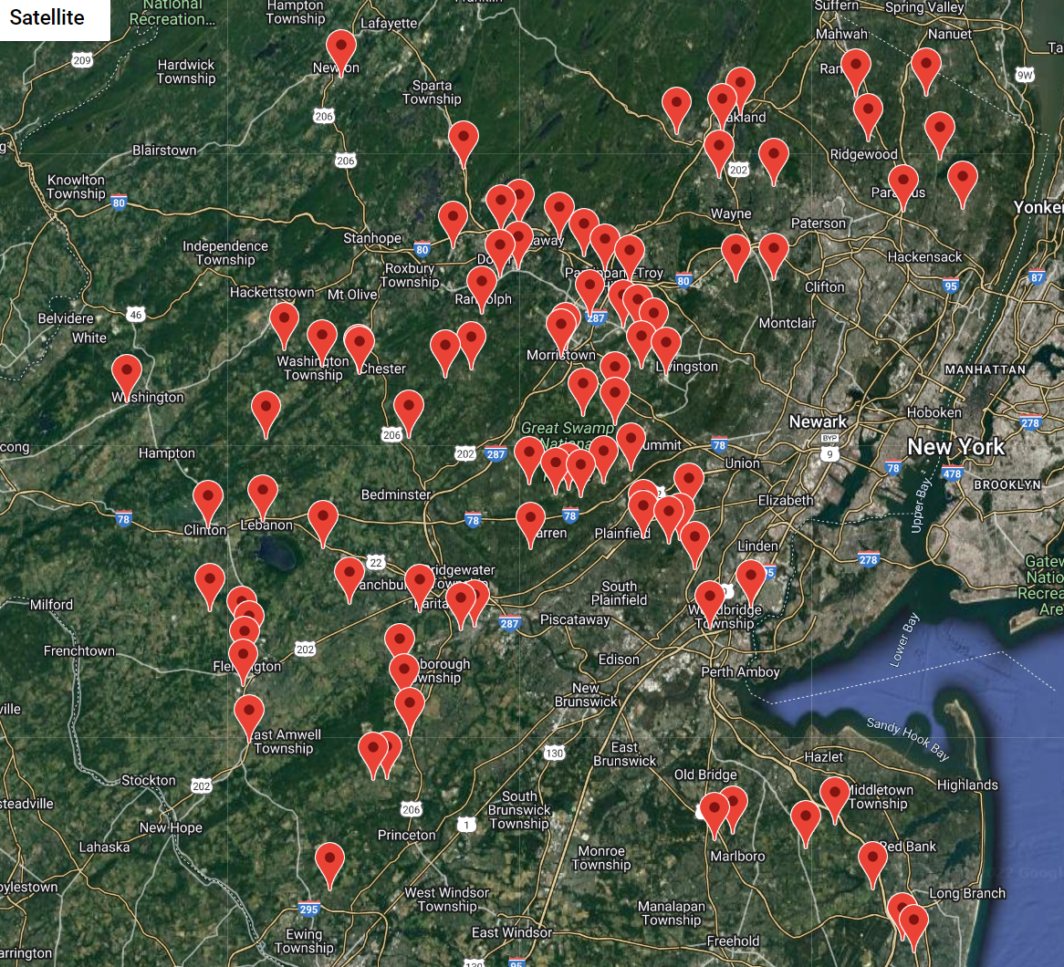
Since 2013 New Legacy Books has raised over $240,000.00
Non-Profits
Townships
Churches
Fire Stations
First Aid Squads
86 Book Bin Locations

Slide 5
How our book processing works

Slide 6
Acceptable Books
Any book that has an ISBN bar code

Slide 7
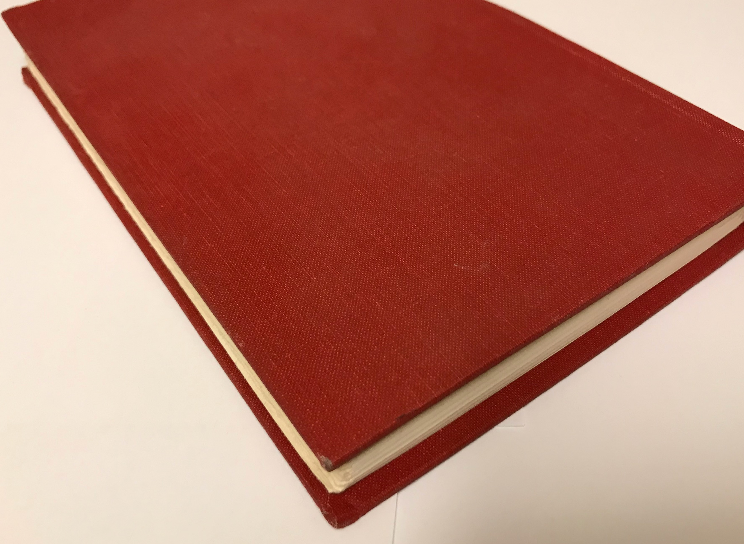
Unacceptable Books
Books that DO NOT have an ISBN bar code

Slide 8
Looking for bin hosts in Bergen, Essex, Hunterdon, Mercer, Middlesex, Monmouth, Morris, Somerset and Union.
Non-Profits
Churches
Recycling Centers
Town Halls
Fire Stations
First Aid Squads
or
For-Profits Companies
looking to raise funds for a charity organization

Slide 9
New Legacy Books
www.newlegacybooks.com
info@newlegacybooks.com

